Slide 1
NAAN MUDHALVAN DATASCIENCE FUDAMANETAL PROJECT
PROJECT TITLE:
Agriculture & Rural Development in Nepal
PRESENTED BY:
VETRIVEL.P
SACS M.A.V.M.M. ENGINEERING COLLEGE
III YR MECH DEPT

Slide 2
Problem solution
By Utilizing the pandas and visualization skills to determining the agricultural and rural development trends in nepal
The development trends will be separated and explored by the given csv datasets.

Slide 3
Project statement
Our goal is to complete the task below based off the article and see if you reach a similar conclusion. Determinig the agricultural and rural development trends in nepal.

Slide 4
System approach
Building the proposed solution would involve a combination of data processing, python programming and visualization skills.
System requirements:
Hardware :
A computer with sufficient processing power, preferably with multiple cores or a GPU for faster training of machine learning models.
Adequate RAM to handle the size of the dataset and computational requirements.
Software:
- An operating system compatible with the required python libraries (e.g., windows,linux,macOS).

Slide 5
System approach – CONT.
Library Requirements:
Data processing and analysis:
Pandas : For data manipulation and analysis.
Numpy : For numerical operations on data.
Data visualization:
Matplotlib and seaborn: For creating visualizations to understand data patterns.
Plotly or Bokeh: Interactive visualization libraries for more complex visualizations.

Slide 6
ALGORITHM & DEPLOYMENT
Algorithm selection
Data exploration :
Explore the movie rating structure, features and variables.
Identify potential patterns, correlations and outliners.
Problem formulation:
Define the problem: Predict optimal booking times, likelihood of special requests based on historical data.
Algorithm selection:
Regression tasks(e.g., predicting daily rates)
Consider linear regression, decision tree, or ensemble methods
classification tasks(e.g., predicting special requests);
Consider logistic regressive, decision trees or random forests.

Slide 7
ALGORITHM & DEPLOYMENT
Data input:
Data collection:
Gather historical data including booking dates ,special requests,and relevant details.
Data cleaning:
Handle missing values, outliners, and any inconsistencies in the dataset.
Convert categorical variables into numerical representation through encoding techniques.
Feature Engineering:
Create new features or modify existing ones based on domain knowledge.
Extract meaningful information from date variables, such as day-of-week or month.

Slide 8
ALGORITHM & DEPLOYMENT
Training process:
Data splitting:
Divide the dataset into training and testing sets to evaluate the model’s performance.
Feature scaling:
Standardize or normalize numerical features to ensure they have consistent scale.
Modeling training:
Use the selected algorithm to train the model on the all sites scores dataset.
Adjust hyperparameters to optimize model performance.
Model evaluation:
Evaluate the model on the dataset using appropriate metrics(e.g., Mean Squared Error for regression,accuracy,precision, recall for classification).
Fine-tune the model if necessary.

Slide 9
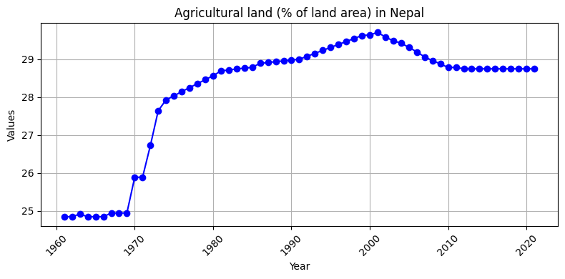
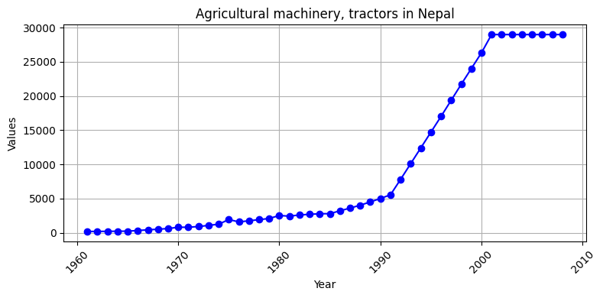
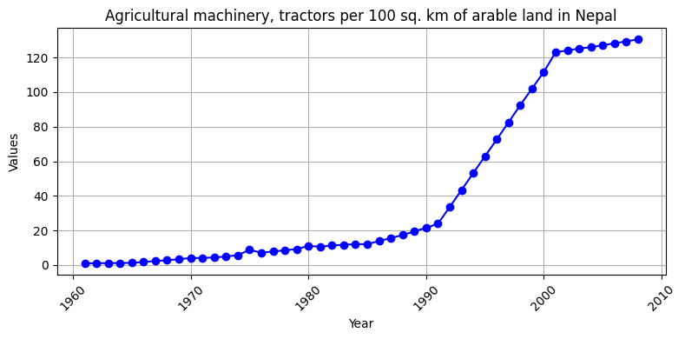
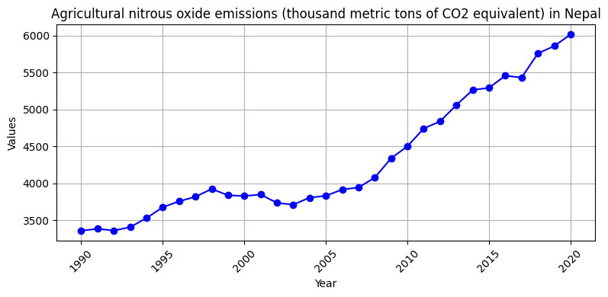
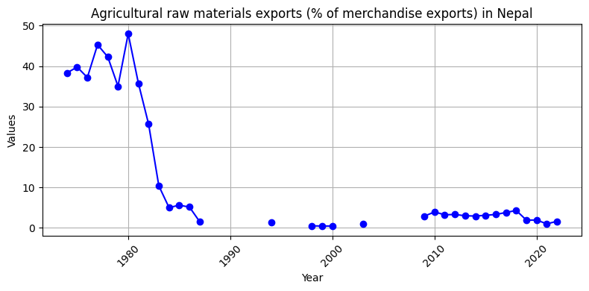
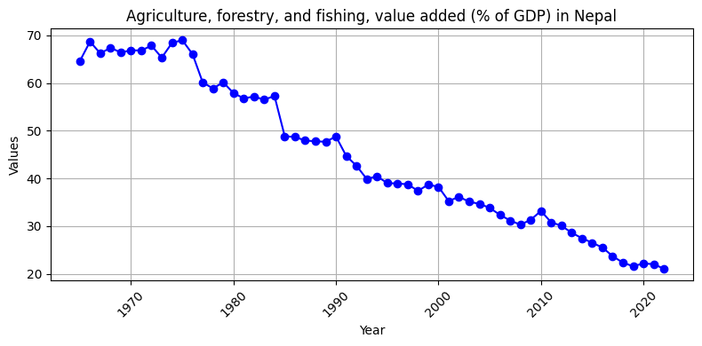
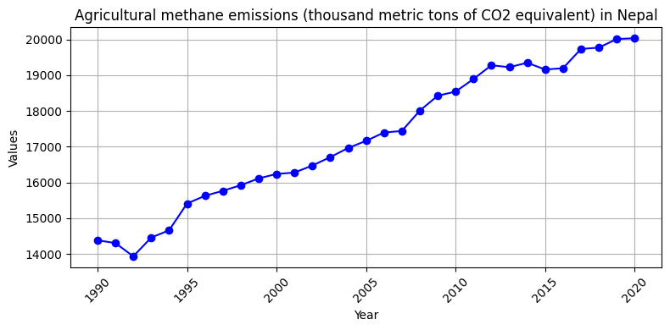
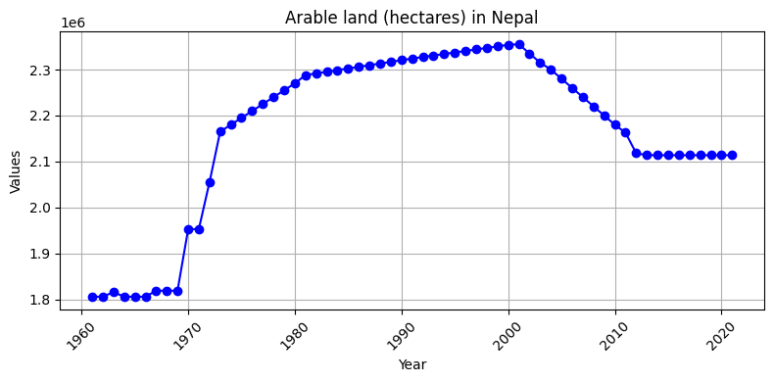
RESULT

Slide 10
CONCLUSION
It proved that and we have determined the agricultural and rural development trends in nepal was done and analyze fully by visualstudio

Slide 11
REFERENCES
http://www.kaggle.com/datasets
http://pandas.pydata.org/pandas-docs/stable/user guide/ index.html
http://seaborn.pydata.org/
http://matplotlib.org/stable/contents.html

Slide 12
Thank you

